Slide 1


Passport for Work
27 June 2022

Slide 2
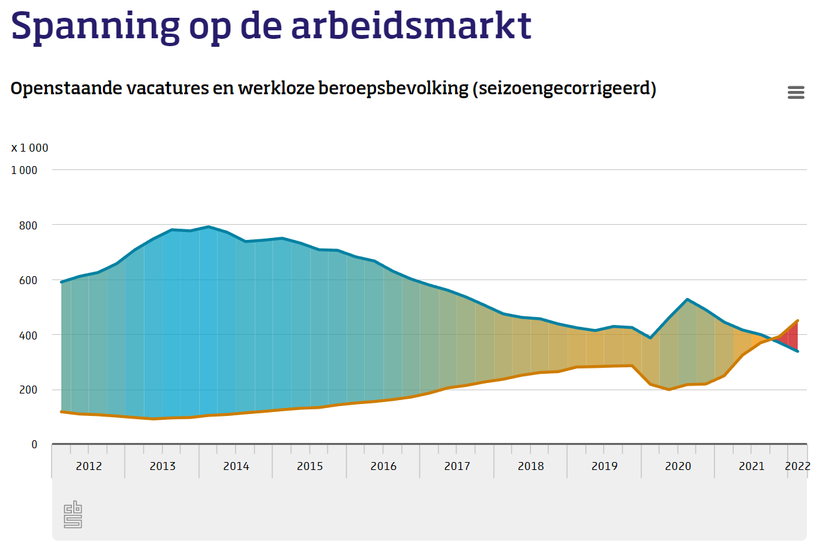

Mismatches on the labour market: caused by a lack of transparancy

Slide 3
A skill-based economy as part of the solution

Slide 4

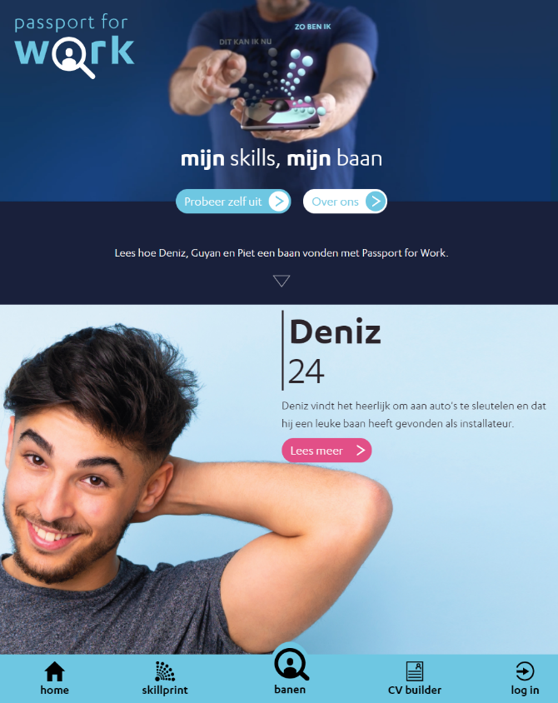
Passport for Work: A 3-year urban innovation project

Slide 5
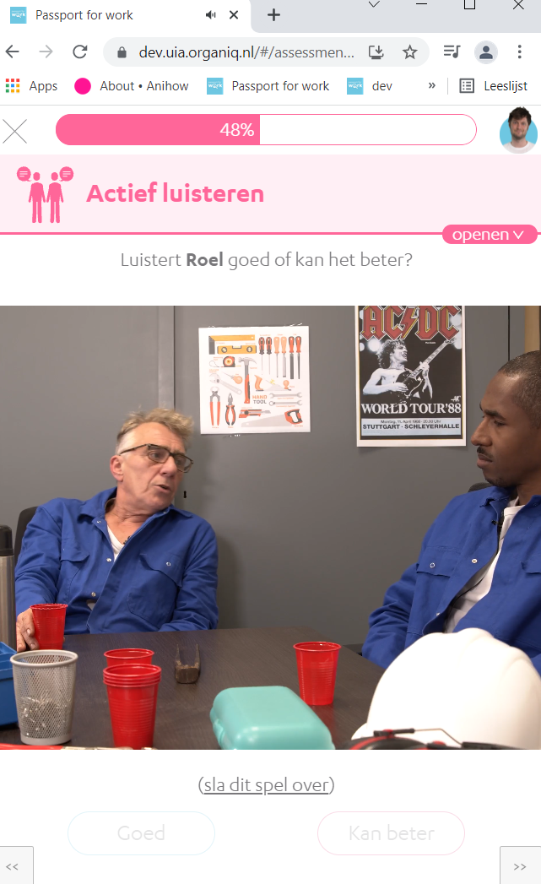
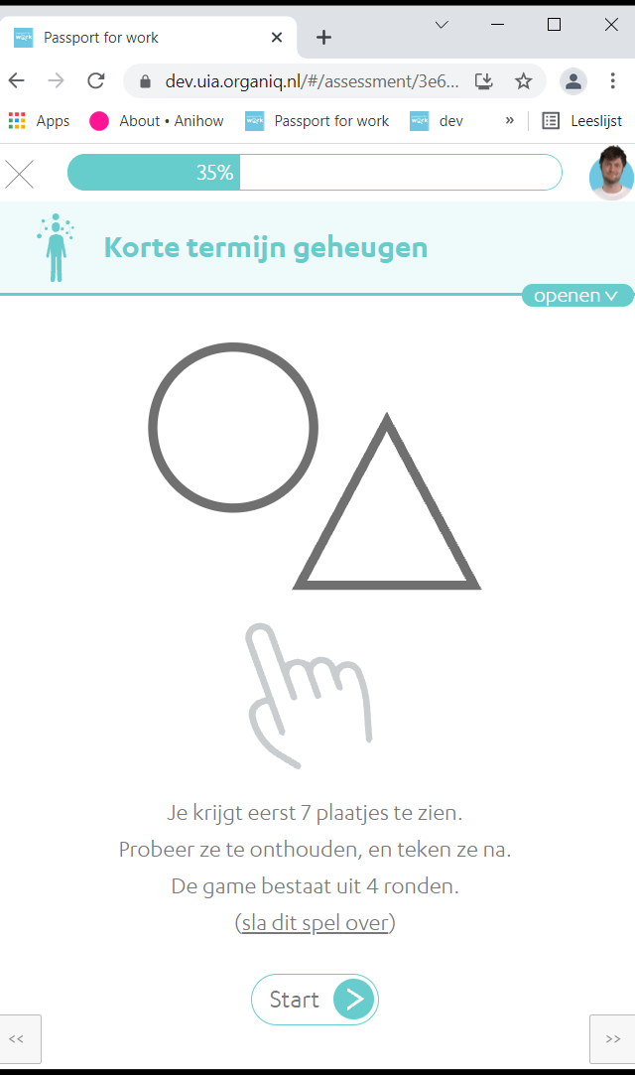
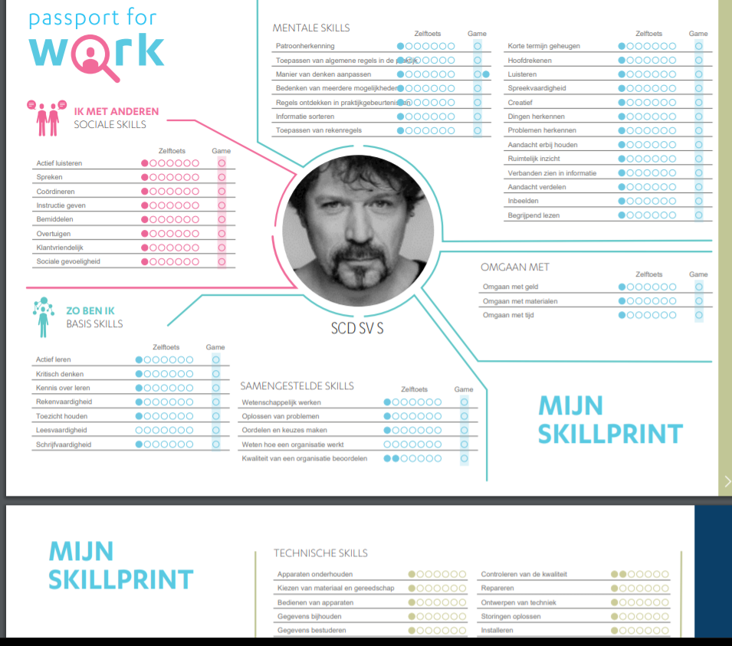
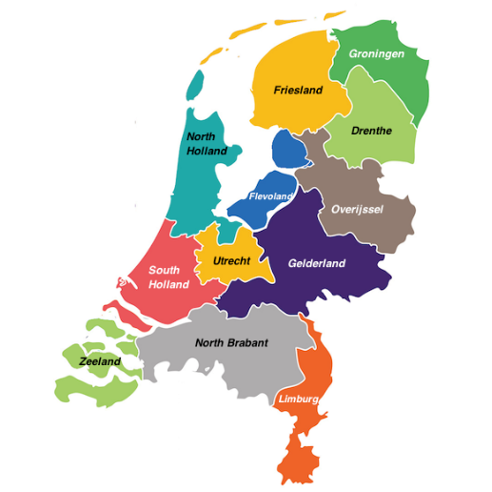

Three key features of the project
1. Towards a Dutch national skills language
2. Gamified assessment
3. Bias-free, skill-based hiring
This project is co-financed by the European Regional Development
Fund through the Urban innovative Actions Initiative

Slide 6
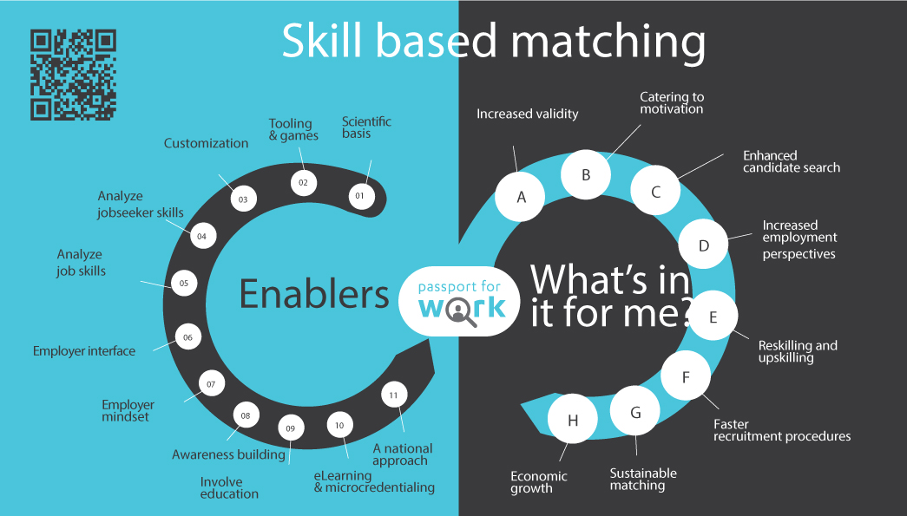

Slide 7
SKILL = Expertise * Behavioural Repertoire
Expertise
Behavioural repertoire
Knowledge, Experience and Insight available that is necessary or useful given the fixed characteristics of a problem or task
Behaviour, Attention and Emotion available that are necessary or useful given the changing circumstances in which a task must be performed
Expertise
Behaviour
Skill

Slide 8
Behavioural Repertoire
Personality
Temperament
Intuition
Behaviour

Slide 9




Healthcare care
Technical industry
Construction
Communication
Communication
Communication
Communication
Sociability
Skills
Sociability
Sociability
Collaboration
Collaboration
Collaboration
Collaboration
Active listening
Active listening
Active listening

Slide 10

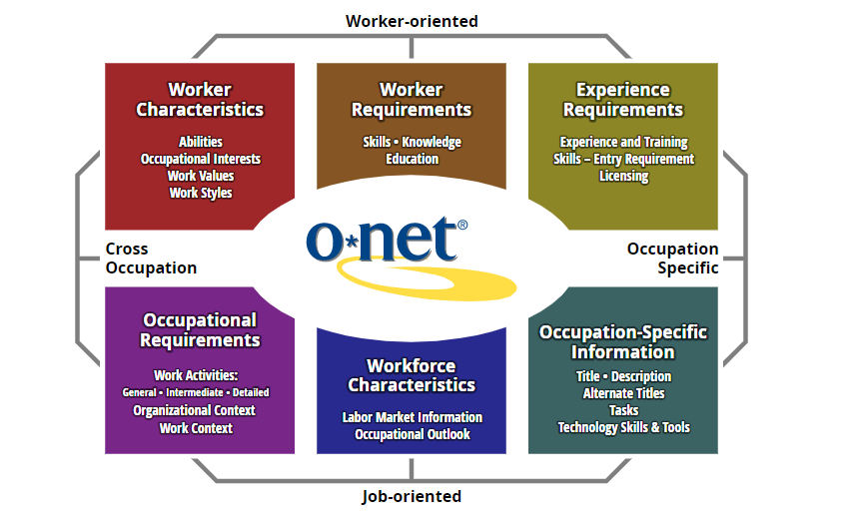
O*NET Skills
Achievement/Effort
Adaptability/Flexibility
Analytical Thinking
Attention to Detail
Concern for Others
Cooperation
Dependability
Independence
Initiative
Innovation
Integrity
Leadership
Persistence
Self Control
Social Orientation
Stress Tolerance
Work Styles
Active Learning
Active Listening
Critical Thinking
Learning Strategies
Mathematics
Monitoring
Reading Comprehension
Science
Speaking
Writing
Basic Skills
Coordination
Instructing
Negotiation
Persuasion
Service Orientation
Social Perceptiveness
Social Skills
Complex Problem Solving

Slide 11
Bartram (2005)
Personality
Ability
Behaviour
Negotiation
Persuasion
Social orientation
Speaking
Initiative
Leadership
Achievement/effort
Adaptability/flexibility
Self control
Stress tolerance
Concern for others
Cooperation
Social perceptiveness
Active listening
Dependability
Integrity
Complex problem solving
Critical thinking
Mathematics
Writing
Active learning
Analytical thinking
Independence
Innovation
Learning strategies
Reading comprehension
Science
Attention to detail
Coordination
Instructing
Monitoring
Persistence
Service orientation
Interacting | Presenting
++
+
+
Leading | Deciding
+
+
Enterprising| Performing
+
+
Adapting | Coping
+
+
+
+
F_{skill}(x) = Σ (α_{p}β_{personality} + α_{a}β_{ability} + α_{b}β_{behaviour} + ε)/ _{df}
Supporting | Cooperating
Analysing | Interpreting
+
++
Creating | Conceptualising
++
+
Organising | Executing
+
+

Slide 12
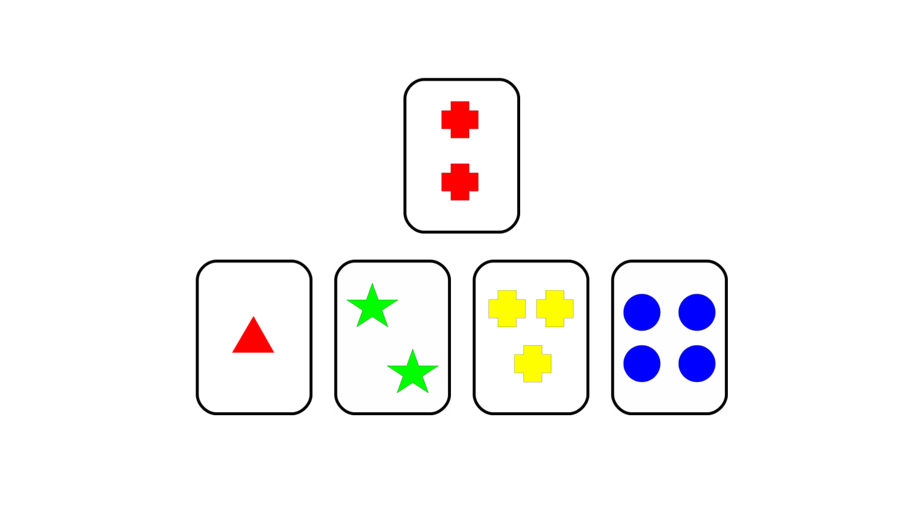
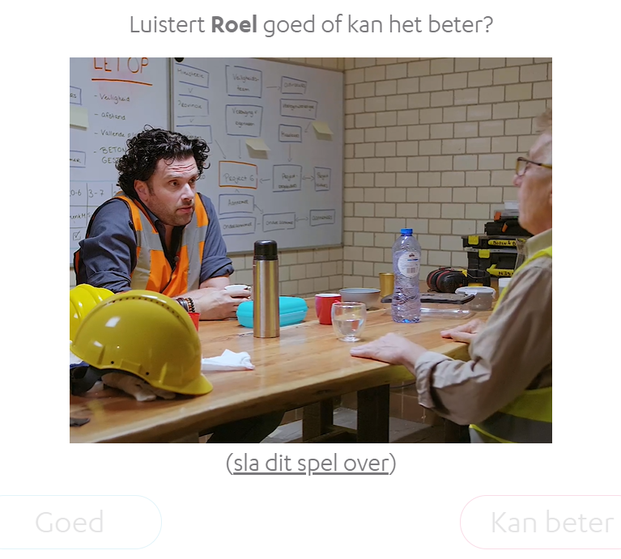
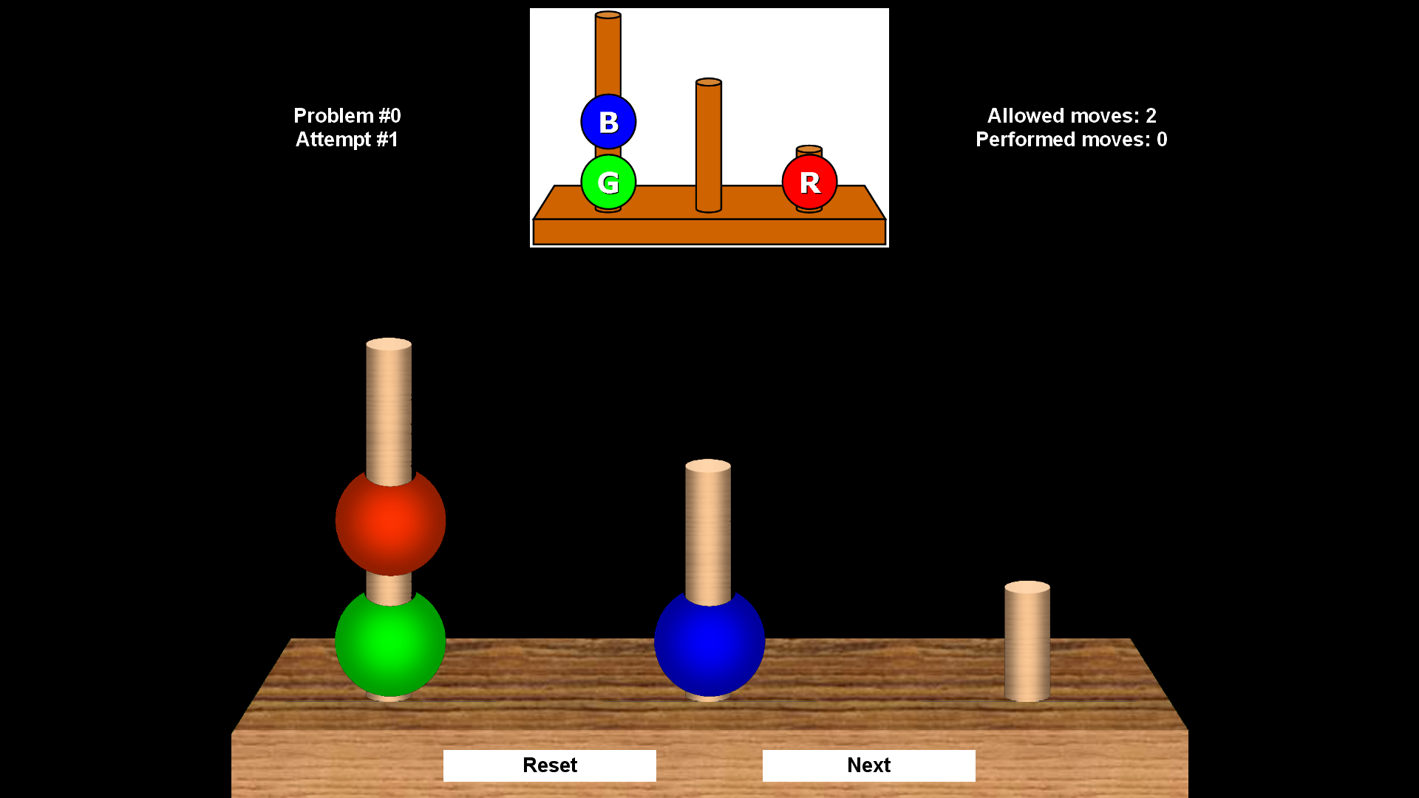
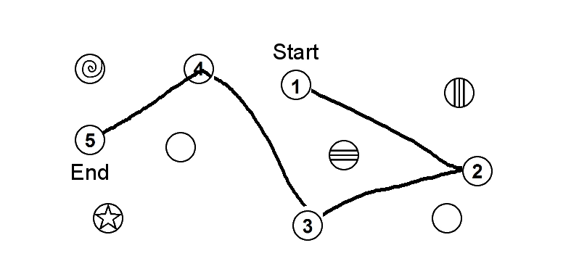
Predictors
H
E
X
O
A
C

Slide 13

